Slide 1

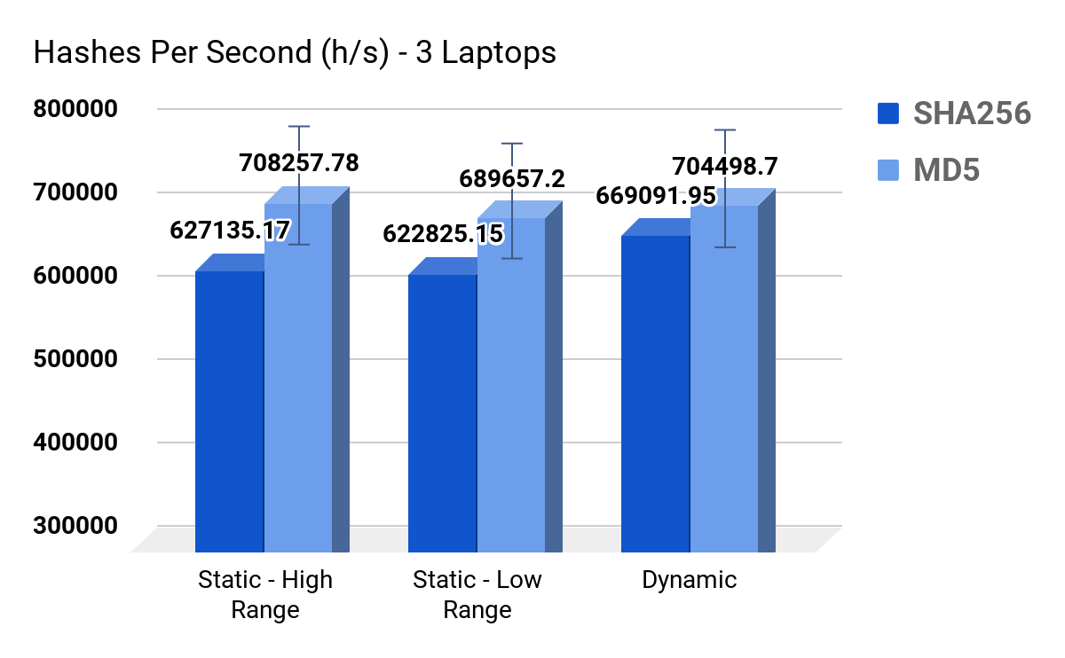
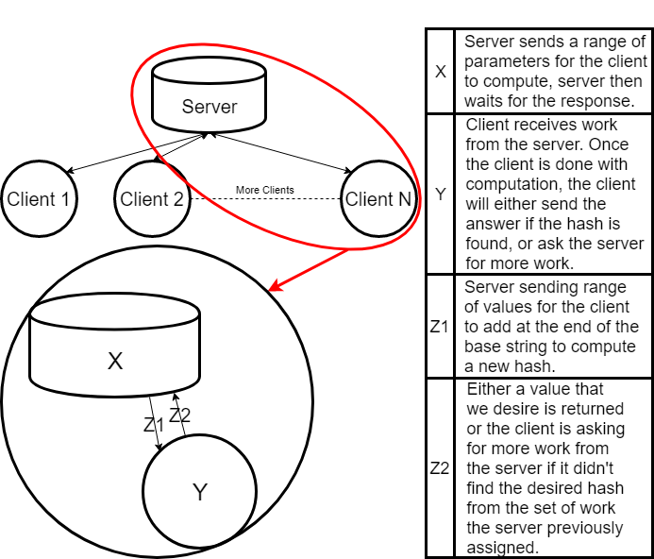
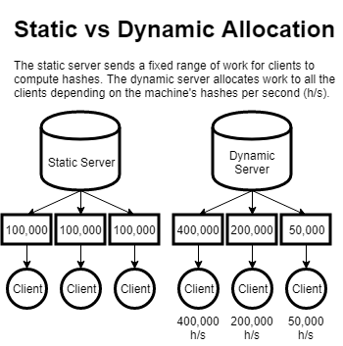
Finding an Optimal Model for Cryptocurrency Mining
Tests and Results
Related Concept: Botnets
Syd Lynch, Charlie Plachno, Danny Lu
University of Oregon
In a series of 60-second tests of three mid-range laptops working at once and two hashing algorithms, our results show that dynamically distributing the work leads to more hashes per second on average. This is roughly 2.5 times the hashrate of one machine.
A network of every computer on the globe could theoretically provide the outperform bitcoin’s network. In the real world however, it is difficult to get other machines to contribute to a network without some sort of compensation for their work. An efficient but unethical way around this problem is to make computers contribute to the network against their will. These networks are called botnets. Botnets infect victim machines and have them run proof of work computations without the users permission.
Background and Problem
How Does Cryptocurrency Mining Work?
The proof-of-work problem requires many calculations to find a suitable hash. Let's say the base string is "Hello, world!". Our target is to find a variation of it that SHA-256 hashes to a value beginning with '000'. We vary the string by adding an integer value to the end called a nonce and incrementing it each iteration. In this example, finding a match for "Hello, world!" takes 4251 iterations:
"Hello, world!0" => 1312af178c253f84028d480a6adc1e25e81caa44c749ec81976192e2ec934c64 "Hello, world!1" => e9afc424b79e4f6ab42d99c81156d3a17228d6e1eef4139be78e948a9332a7d8
"Hello, world!4250" => 0000c3af42fc31103f1fdc0151fa747ff87349a4714df7cc52ea464e12dcd4e9
Is there a theoretical optimal model for mining?
Using a simulated mining environment, we tested multiple models of computing the proof-of-work and compared the results. Our central goal was to determine if it would be possible for many standard machines to compete with dedicated mining machines.
Hashing Algorithm
The Selfless Model
Research Findings
Hypothesis: a network of average computers would outperform a dedicated mining machine in computing the proof-of-work.
Conclusion:
*assuming every laptop computes 400,000 H/s*
Laptops vs. ASIC: 2.5M Laptops to compute 1 TH/s to compete with an ASIC AntMiner computing 1 TH/s.
Laptops vs. GPU: 1250 Laptops to compute 500 Mh/s to compete with a GTX Titan V GPU.
The concept of combining processing power for a central goal is theoretically optimal, but realistically it would be difficult or impossible to implement in the most popular cryptocurrencies such as Bitcoin.

